Slide 1
Stock Sentiment Analysis

Slide 2
Introduction
Sentiment analysis is the process of analyzing digital text to determine if the emotional tone of the message is positive, negative, or neutral.
In the investing context, it will show a Market Sentiment towards a financial product.
In this project we analyzed a list of stocks from the US Markets.
The result of the analysis is a Sentiment Score in the range of (-1, 1), where -1 represents extremely negative sentiment, and +1, extremely positive sentiment towards the stock.
This information can be used as a tool, in conjunction with other methods, to help inform the investing decision.

Slide 3
Sources
www.finviz.com – source for stocks news
www.yahoo/finance - source for stock prices

Slide 4
Methods
1. Collecting the data
Web Scraping – finviz.com – for the articles on stocks
HTML parser using BeautifulSoup
API calls – Yahoo Finance – for the stock prices
2. Transforming the data
The data has been organized in Data Frames using Pandas
3. Cleaning and organizing the data
Removing empty (NaN) rows
Changing data types
Adding new columns
4. Analysis
The data has been analyzed using the Vader SentimentIntensityAnalyzer from the NLTK module
5. Visualization
The results were presented in bar and line charts using matplotlib module

Slide 5
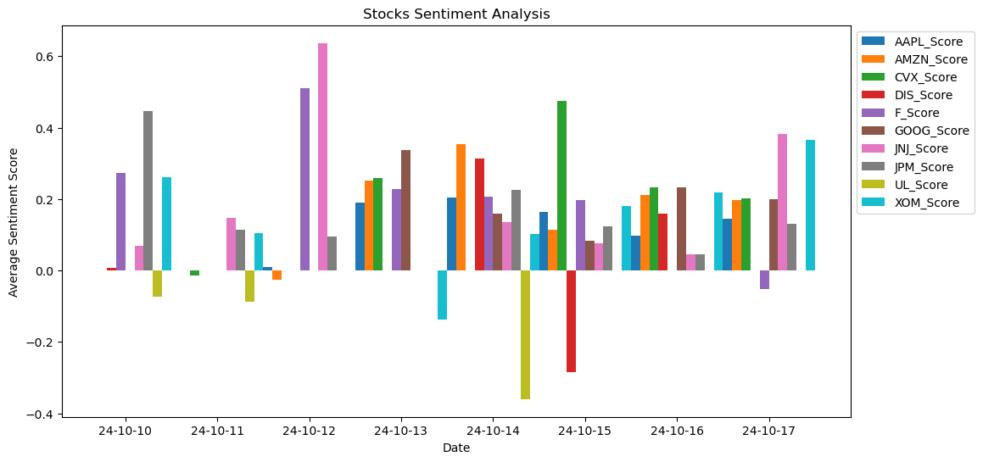
Results

Slide 6
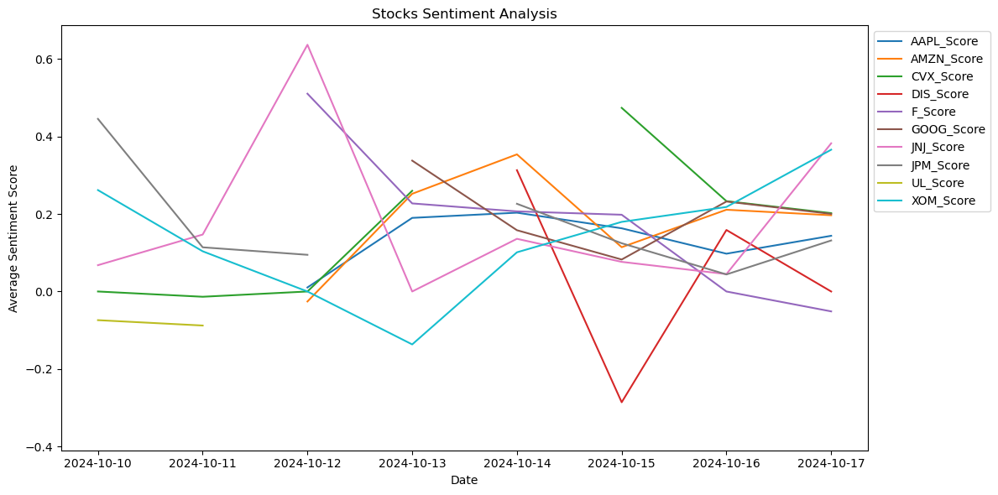

Slide 7
Stocks Sentiment Score vs Price

